Slide 1

My Premises
It was a cardinal mistake to introduce the Euro as widely as it was – but the Euro itself was not.
It is too late to turn back in midstream.
The credibility of a monetary union requires that it not be decided over the heads of the people.
The long-run future of the Euro relies on a renaissance of the national No-Bailout-Principle
Return from fiscal to monetary dominance
To get there, the ECB’s hand must be strengthened in the long run. How to do this?

Slide 2
What will the ECB look like in 2023?
Weighty decisions will or will not be taken in the next 12-24 months, everywhere in Europe.
OMT is a side-show compared with the LTRO and its refinancing due in 2015-6
Questions of collateral haircuts for rediscounting have not been resolved and are highly political
So are bailouts and bank resolution
The banking union raises even more questions involving the long-run viability of the ECB

Slide 3
The ECB must be reformed
To restore monetary dominance in the long-run the credibility problem must be solved.
It is a question of political economy. Who wants No-Bailout? Is there a coalition for this position? Do other countries want fiscal union?
The ECB’s hand must be strengthened vis-à-vis the national governments.
How to do this credibly?
Eliminate national central banks as a lobby for national interests: Redesigning the ECB!

Slide 4
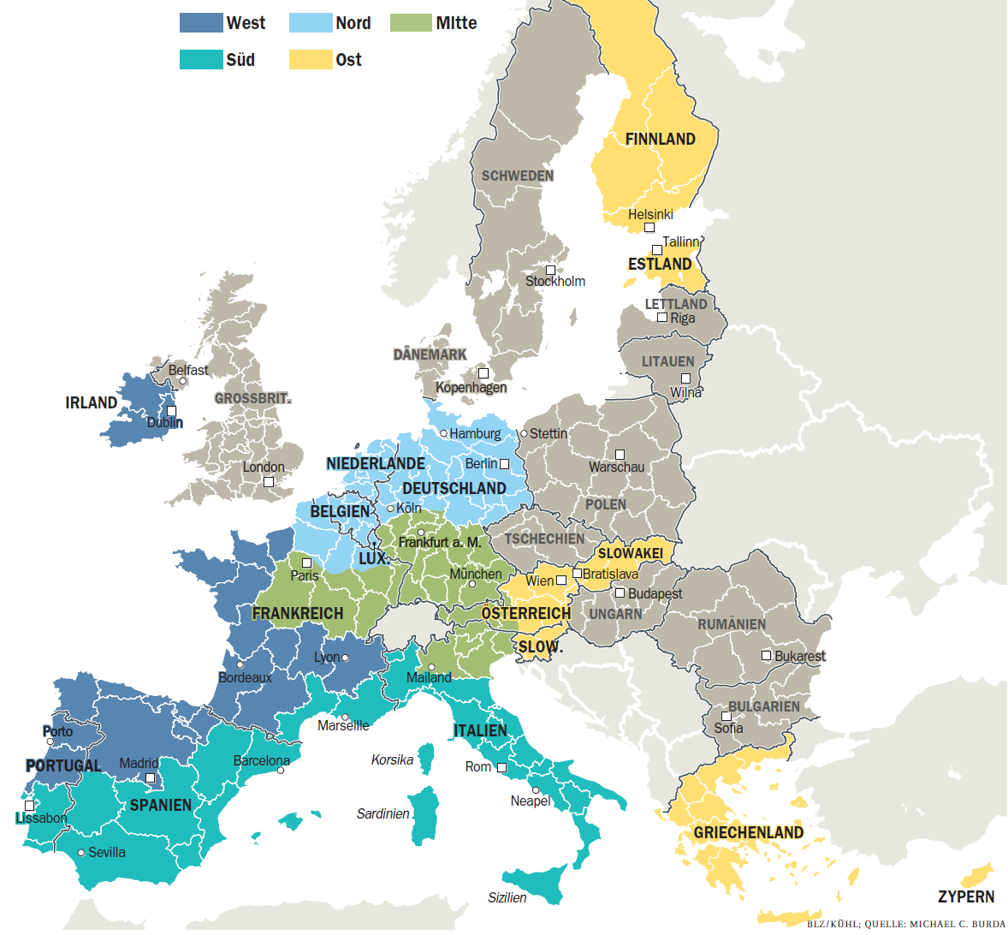
The ECB redrawn

Slide 5
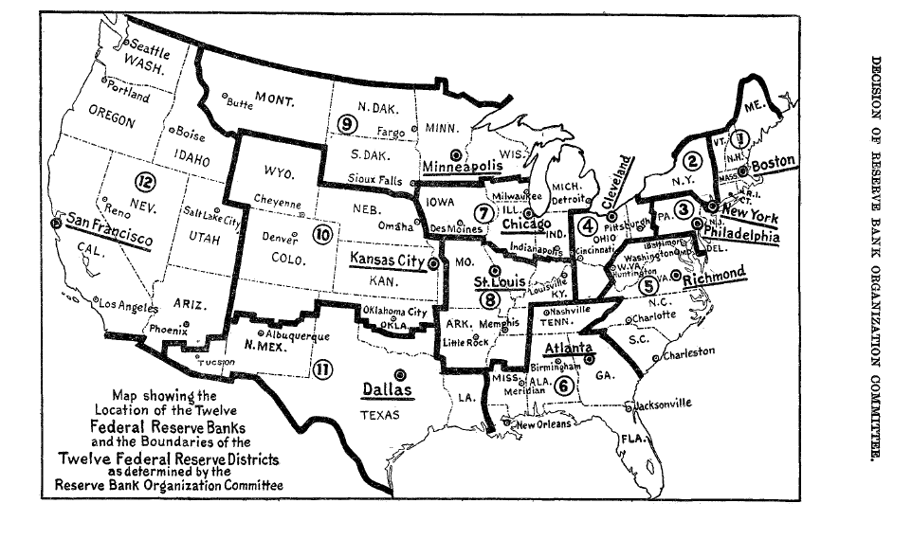
The Fed in 1913
Quelle: Decision of the Reserve Bank Organization Committee Determining The Federal Reserve Districts and the Location of Federal Reserve Banks under Federal Reserve Act approved December 23, 1913 Washington: Government Printing Office (1914)

Slide 6
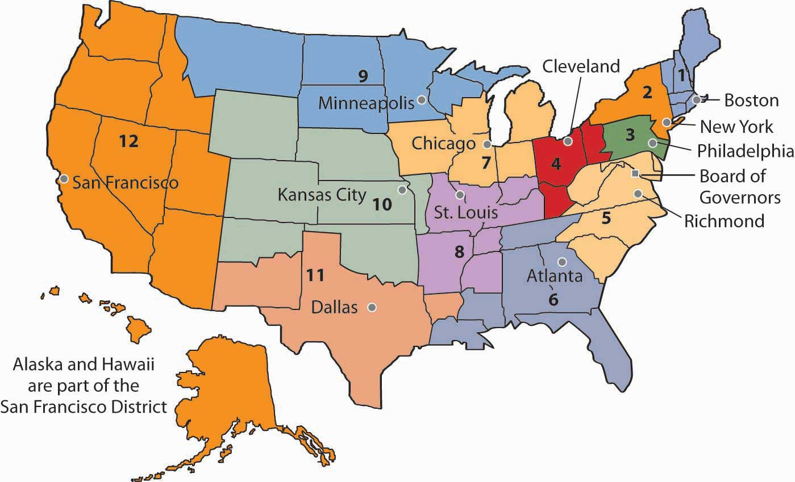
The Fed in 2013
Quelle:
Notes:
6

