Slide 1
Experiments on gender differences in preferences: Thinking about power, p-values and effect sizes (focus on risk preferences), and exploring the role of sex hormones
Anna Dreber Almenberg
Stockholm School of Economics
Gender Economics Workshop Berlin 2018
Joint with many coauthors

Slide 2
Gender differences in economic preferences
From lab experiments:
Risk preferences
Willingness to compete
Negotiation
Social preferences?
Linked to important economic outcomes
But which results can we trust?
For example, did the study set out to study behavior or gender?

Slide 3
This hour
Which results can we trust?
Statistical power and p-values
Researcher degrees of freedom
Effect sizes
Gender differences in risk taking
Discussed by e.g. Julie Nelson, Muriel Niederle
The potential role of sex hormones in explaining some of the gender gaps in economic preferences

Slide 4
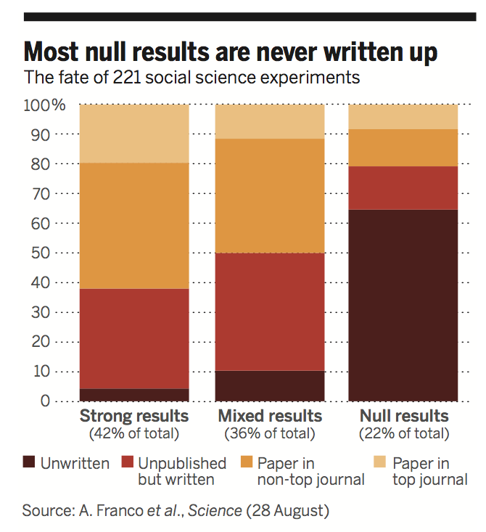
How many published claims are false?
Type 1 errors
Type 2 errors
Ioannidis 2005 PLoS Medicine: Why Most Published Research Findings Are False

Slide 5
Statistical power
Power calculations based on some assumed effect size
Empirical: Based on previous studies
Problem: Exaggerated effect sizes!
Or Nthe actually observed result!
Rare goal: The minimum effect size that would be important to find
But how do we talk about effect sizes? More soon
Problems with low power: Not just false negative and false positive results, but also Type M (Magnitude) and Type S (Sign) errors
In sum: p<0.05 combined with low power can be very misleading
Gelman A, Carlin J, 2014. “Beyond power calculations: Assessing Type S (sign) and Type M (magnitude) errors”. Perspectives on Psychological Science, 9, 641-651.

Slide 6
Low power
Gelman A, Carlin J, 2014. “Beyond power calculations: Assessing Type S (sign) and Type M (magnitude) errors”. Perspectives on Psychological Science, 9, 641-651.

Slide 7
Low power: example
Menstrual cycle and vote preferences:
Comparing women across cycle (between-subject)
Several hundred participants
Difference in 17 percentage points in vote preferences in a 2012 pre-election study
p=0.035
Gelman A, Carlin J, 2014. “Beyond power calculations: Assessing Type S (sign) and Type M (magnitude) errors”. Perspectives on Psychological Science, 9, 641-651.

Slide 8
Low power: example
Vote swings are small!
In general, selection into who answers polls biggest explanation to swings, not shift in preferences
Effect size of 2 percentage points upper end of plausible differences in vote preferences
Power 0.06
Type S error probability of 24%
Type M error factor of 9.7
Gelman A, Carlin J, 2014. “Beyond power calculations: Assessing Type S (sign) and Type M (magnitude) errors”. Perspectives on Psychological Science, 9, 641-651.

Slide 9
Power in economics
Ioannidis et al: 159 empirical economics literatures with more than 6700 studies: median power of 18%
21% in neuroscience(!) (Button et al. 2013)
Zhang and Ortmann: Dictator game experiments: median power of 25% and average of 38%
Power in gender economics?
Ioannidis et al 2018g Economic Journal; Zhang and Ortmann WP 2013

Slide 10
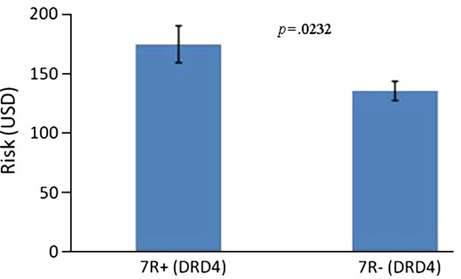
Candidate genes
Dreber et al. 2009 Evolution and Human Behavior

Slide 11
Researcher degrees of freedom
Fishing
P-hacking
Forking
Ioannidis 2005 Why Most Published Research Findings Are False; Simmons, Nelson and Simonsohn 2011 False-Positive Psychology: Undisclosed Flexibility in Data Collection and Analysis Allows Presenting Anything as Significant; Gelman and Loken 2013 The Garden of Forking Paths

Slide 12
P-hacking
Many ways to get p<0.05
Stop collecting data once p<.05
Analyze many measures, but report only those with p<.05
Collect and analyze many conditions, but only report those with p<.05
Use covariates to get p<.05
Exclude participants to get p<.05
Transform the data to get p<.05
Simmons, JP, LD Nelson, U Simonsohn, 2011, False-Positive Psychology: Undisclosed Flexibility in Data Collection and Analysis Allows Presenting Anything as Significant. Psychological Science 22(11): 1359-1366.

Slide 13
Simmons, JP, LD Nelson, U Simonsohn, 2011, False-Positive Psychology: Undisclosed Flexibility in Data Collection and Analysis Allows Presenting Anything as Significant. Psychological Science 22(11): 1359-1366.

Slide 14
P-hacking in economics
Brodeur et al. 2016 AEJ: AE

Slide 15
Forking
Study: We want to understand altruism from a dictator game. Hypothesis that the gender of the recipient matters
So many forks!
Effect could be that everybody gives more to men
Everybody gives more to women
Men give more to men
Men give more to women
Or women give more to men
Or women give more to women
Or men and women have opposite effects
Maybe interacts with age
How to define altruism? How much you gave or whether you gave?
What tests, parametric or non-parametric?
Etc – even if hypothesis is more precise
Enough with one test and you are forking
What does the p-value mean here?

Slide 16
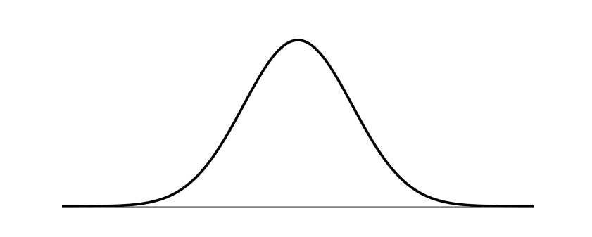
Gender difference at different levels
At the individual level (GDI): A difference that categorically distinguishes men and women
Any pairwise comparison of randomly selected men and women would confirm GDI statement
Few GDIs out there
At the aggregate level (GDA): A difference that can only be found at the aggregate, group or distributional level
Difference between men’s and women’s average values
The smaller the difference in averages and the larger the variation in each group, the more overlap in distributions and the less the GDA resembles the GDI
E.g. wages, heights, test scores
Julie Nelson 2015 Feminist Economics

Slide 17
GDI, GDA and Cohen’s d
Most papers are about GDA but written and communicated as GDI
Size of the GDA important
Solution: Talk about effect sizes: Cohen’s d
d=(mean(X_{m})-mean(X_{f}))/S_{p}
Sp is the pooled standard deviation, measure of average within-group variation
Positive d: Male average exceeds the female average

Slide 18
d=0.2 “small”, d=0.5 “medium”, d=0.8 “large”
For GDI d=3.0. For height etc, d=1.8
From Nelson 2015

Slide 19
Cohen’s d and gender differences in risk preferences
Croson and Gneezy 09: 11/13 studies find M>F. Nothing on d.
Charness and Gneezy other review in 2012
Gender differences in an investment game where subjects decide how much $x of an endowment they will invest in a risky asset rather than keep with certainty. % invested measure of risk taking

Slide 20
Nelson’s review of all studies on this task (30+ studies)
d=0 is within the CI (meaning that the null hypothesis of no difference cant be rejected at 5% level) for 25/37 studies
d=2 for 2 studies
No d=3
Strong statistical evidence against GDI interpretation of risk differences
Mixed statistical evidence concerning any difference at all

Slide 21
Nelson’s review of all studies on this task (30+ studies)
Pooling all observations (N=1940): male mean=64%, female mean=49%, p<0.001, d=0.49, probability that a randomly chosen man would score higher than a randomly chosen woman=64%
To have 80% power to find this type of d, N has to be at least 128
Why satisfy with 80%? And given this, what’s the median power in gender experiments?
(For other risk taking reviews d is smaller (0.2 which would imply sample sizes above 600), Niederle and Vesterlund willingness to compete d=0.80)

Slide 22
Potential explanations to gender differences in average (risk) preferences

Slide 23
Sex hormones and risk preferences
Growing interest in sex hormones in economics
Testosterone, estrogen, progesterone
Why should these matter?
Testosterone and behaviors in (non-human) males
Menstrual cycle effects (psychology)
Notes:
Many of the randomized studies on sex hormones and economic behavior are small with limited statistical power to detect effects and an increased risk that “significant” findings are false positives (Button et al. 2013) (n=24 in van Honk et al. (2012), n=48 in Zak et al. (2009), n=24 in Bos et al. (2010), n=54 in Boksem et al. (2013)). The literature may also suffer from publication bias (Easterbrook et al. 1991; Ioannidis et al. 2014), and it cannot be ruled out that some null results have failed to get published. It is interesting to note that the largest randomized study up to the current one (n=200 in Zethraeus et al. (2009)) only found null results.

Slide 24
Sex hormones and risk preferences
Early correlational evidence somewhat promising: Positive correlation between T and risk taking in men
But then lots of inconsistent results
General problem: Testosterone supposed to be associated with high status
What’s a high status behavior? High or low altruism? Etc
Another problem: Interactions with cortisol
Inconsistent results on menstrual cycle
And measurement problems

Slide 25
Sex hormones and risk preferences
Causal experiments part of the solution
With caveat that results can be hard to generalize
Higher doses than normal physiological range
Behavioral effects from other mechanisms besides the targeted hormone system (with effects deviating from what we would observe from endogenous hormones)
So what’s the causal evidence?

Slide 26
Previous causal results
Zak et al. 2009: n=25 within-subject (“200”): No main effect of T in DG or UG but on “generosity”
Zethraeus et al. 2009: n=200 between-subject (3 groups): No effect of T or E in DG, UG, TG, risk
Eisenegger et al. 2010: n=121 between-subject (focus on n=60 proposers in UG): No main effect of T but effect controlling for beliefs
van Honk et al. 2012: n=24 within-subject: No main effect of T in PGG, interaction with 2D:4D
Boksem et al. 2013: n=54 between-subject: No effect of T on risk taking but effects in TG (both players)
Buskens et al. 2016: n=61 between-subject: No effect of T on DG or risk taking but triple interaction with one-shot vs repeated TG and 2D:4D
Kopsida et al. 2016: n=68 between-subject: No effect of T in UG
Cueva et al. 2017: n=38 within-subject: No effect of T in UG (responders)

Slide 27
Previous causal results
In sum: Many failures to reject null hypothesis, low power, some degrees of freedom with many outcome variables etc

Slide 28
Contraceptive pill study
Largest sample size so far: 340 women randomized to contraceptive pill (most prescribed version) or placebo over 3 months
Altruism, willingness to compete and financial risk taking
Placebo group randomized to come back at different times of the cycle for menstrual cycle study
Pre-analysis plan
Ranehill, Zethraeus,…., Johannesson, Dreber in press Management Science

Slide 29
Why is the pill interesting?
Oral contraceptives (the pill) very common
Used by 80% of women in US and Western Europe during some period of life
Key historical role in increasing female labor force participation and investments in careers
Suppresses testosterone levels and mimics pregnancy
Could increase gender gaps in economic preferences like risk preferences?

Slide 30
Our study
340 (171 Placebo, 169 Treatment with the pill) healthy women aged 18-35. Main analysis: N=333 who completed data collection
But also robustness tests for N=340 and N=330
2 visits to the hospital
Baseline: (1) Blood sample, (2) surveys on sexual well-being, general well-being, depressive symptoms, and (3) survey on facial preferences
End of Treatment: As Baseline with additional economic experiment at the end
10 or 11 weeks of treatment period (randomized to vary menstrual cycle phase at End of Treatment for normally cycling women)
158/168 participants in placebo-group classified into specific cycle phase based on measured hormone levels (follicular, ovulatory, luteal phase)

Slide 31
Economic preferences
Altruism (or DG giving)
Dictator game (DG) with charities. 5 decisions to share SEK 100 with 5 different charities. Our measure is the average DG giving across the 5 decisions (one decision was paid out)
Financial risk taking
Multiple price list where participants made 18 choices between a 50/50 bet and a safe option. Our measure of risk taking is the percentage of risky decisions made (one decision was paid out)
Willingness to compete
3 rounds – (1) piece rate incentives, (2) tournament incentives, (3) choice of incentives as in Niederle & Vesterlund 2007. Our primary measure is the binary choice between piece rate or tournament incentives in round 3. As a secondary measurement we look at performance change (one round was paid out)

Slide 32
Hypotheses economic preferences
Based on observed average gender differences (and some correlational studies):
DG giving: The pill increases giving
Risk taking: The pill decreases financial risk taking
Willingness to compete: The pill decreases willingness to compete
Menstrual cycle: ???

Slide 33
Changes in hormones

Slide 34
Results
No effects on 3 main measures of economic decision making
Significant negative effects on general wellbeing (reported elsewhere)
Notes:
Contrary to our hypotheses, we found no significant difference between the OC and placebo group for any of the economic preference measures: altruism (mean difference = -4.10, p=0.218, independent samples T test), financial risk taking (mean difference = -2.31, p=0.264, independent samples T test), and willingness to compete (mean difference = -1.03, p=0.850, chi-square test).

Slide 35
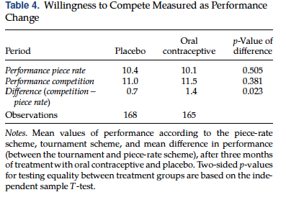
Results

Slide 36
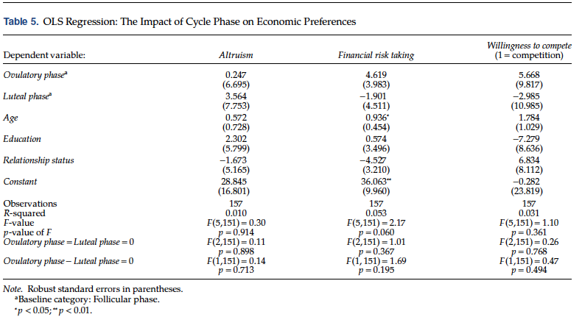
Results
Follicular phase as baseline
Notes:
Follicular phase as baseline

Slide 37
Testosterone administration study
N=241 men
100 mg T (transdermal gel, N=123) vs placebo (N=118) administration for a few hours
Willingness to compete: N&V style adding 5 2-digit numbers, choice of competition vs piece-rate for future performance
Risk task: Multiple price list (choices between certain amount and 50-50 gamble)
Nadler, Camerer, Dreber, Frydman, Previtero, Zava, Nave in progress

Slide 38
Testosterone administration study
No effect on willingness to compete
d=0.06, p=0.63
No effect on financial risk taking
d=0.0, p=0.90
Combining papers with Falk and Wibral
Nadler, Camerer, Dreber, Frydman, Previtero, Zava, Nave in progress

Slide 39
2D:4D
Putative proxy of testosterone exposure in utero
Amniotic fluid, CAH, gender differences
Many degrees of freedom
Which hand? Which group? Squared 2D:4D?
2D:4D in contraceptive pill study
DG giving
Risk taking
Willingness to compete
Your priors?
Parslow et al. in progress

Slide 44
Conclusions sex hormones and economic decision making
Mainly started with smaller noisy studies with inconsistent results
Most cannot reject the null
No evidence for causal results in later larger studies
(N=1000 men and T in progress)
(2D:4D and SOEP with Levent Neyse in progress)
What other fields of gender economics are like this?
Many outcome variables, interactions with bunch of variables, removal of outliers, etc
See new book chapter by Dreber and Johannesson in International Handbook of Social Neuroendocrinology for more

Slide 45
Other thoughts
Pre-analysis plans
Higher power
Team science

Slide 46
p<0.005
Benjamin et al. 2018 “Redefine Statistical Significance” Nature Human Behavior

Slide 47
Thanks! anna.dreber@hhs.se

