Slide 1
The Re-Emerging Privilege of Euro Area Membership
Based on IMF WP 17-162
Johannes Wiegand
International Monetary Fund
February 2018

Slide 2
“Exorbitant Privilege” (Valery Giscard d’Estaing)
USD’s reserve currency status triggers higher demand for USD assets → reduces funding costs and allows the US to run a wider current account deficit.
Empirical evidence generally confirms existence of a USD privilege. Two methods: compare
the average cost of the US economy’s liabilities with the average return on its assets (Gourinchas and Rey, 2007, Lane and Milesi-Ferretti 2005), or
the return on US government bonds with that of peers (Maggiori, 2013)
EBA: USD privilege is worth 2.7 percent of GDP.

Slide 3
Is a Privilege Associated with Euro Area Membership? (1)
… after all, creating an alternative reserve currency was one of the euro’s original objectives.
EBA: assigns privilege in relation to the share in global reserves—euro privilege is 1/3 the size of the USD (0.9 percent of GDP for each member).
Few detailed academic studies. Main exception are papers seeking to explain euro area CDS spreads before and during the euro crisis (JIMF 2013).
Common finding: pre-crisis spreads were lower than what fundamentals would predict, in crisis spreads became wider.

Slide 4
Is a Privilege Associated with Euro Area Membership? (2)
Authors give the result different interpretations:
(i) de Grauwe and Yi: lack of lender of last resort for government bonds (=privilege disappeared as the crisis exposed an architectural flaw)
(ii) Aizenman et al.: investors priced in expected deterioration in fundamentals (=privilege may still have been there)
(iii) Gosh et al.: lack of independent monetary policy hurt in crisis (=privilege is state dependent)
(iv) Beirne and Fratzscher: investors corrected their assessment of fundamentals in crisis, such as public debt (=privilege was an illusion)

Slide 5
Paper Updates, Refocuses and Generalizes the Earlier Studies
Update: trace the evolution of privilege throughout the recovery
Refocus: “privilege” is a longer-term concept → CDS spreads are too volatile and subject to contagion to serve as a basis. Paper extracts a metric of privilege from investor assessments as revealed in risk surveys.
Generalize: allow for both, investors reassessing the value of (i) euro area membership and of (ii) fundamentals during and after the euro crisis (in second part of the paper).

Slide 6
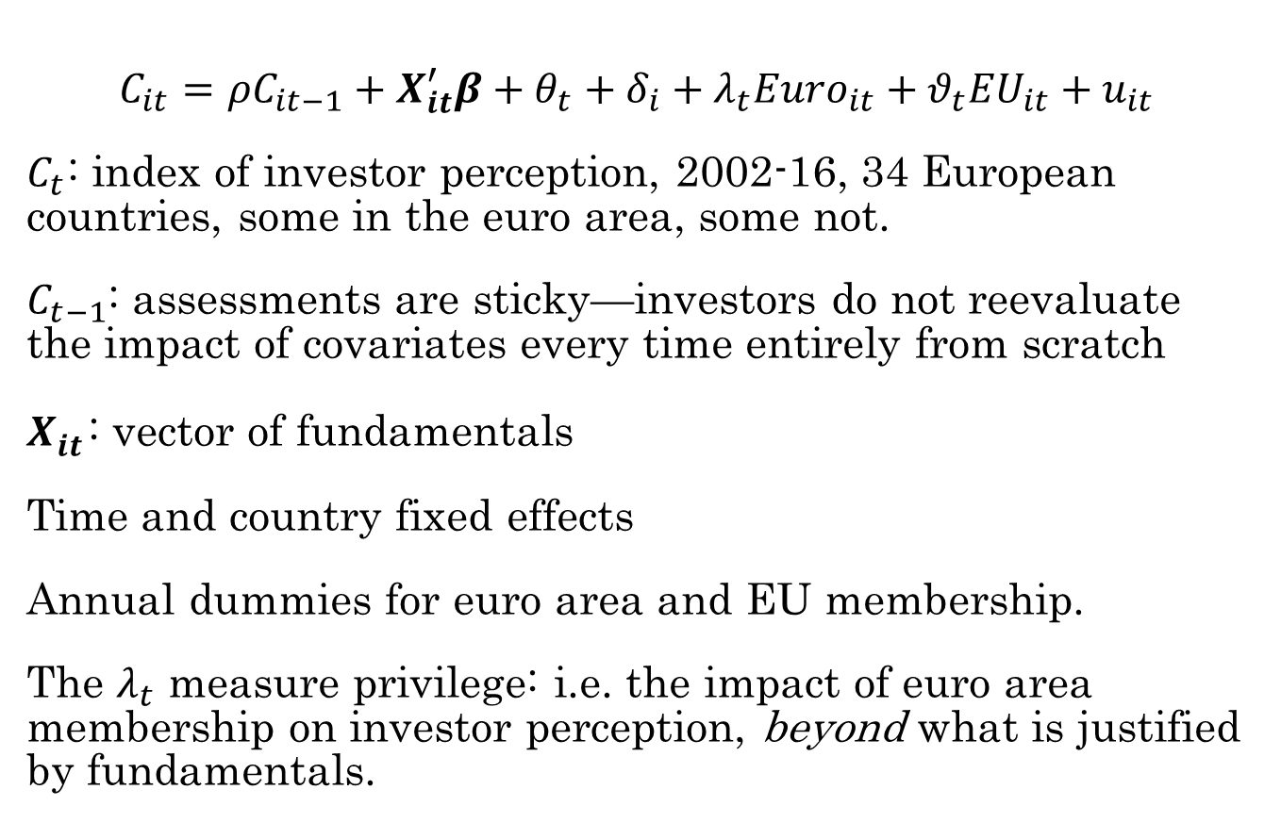
Basic Approach
$$C_{it}={ρC}_{it−1}+X_{it}^{′}β+θ_{t}+δ_{i}+λ_{t}{Euro}_{it}+θ_{t}{EU}_{it}+u_{it}$$
$C_{t}$: index of investor perception, 2002-16, 34 European countries, some in the euro area, some not.
$C_{t−1}$: assessments are sticky—investors do not reevaluate the impact of covariates every time entirely from scratch
$X_{it}^{}$: vector of fundamentals
Time and country fixed effects
Annual dummies for euro area and EU membership.
The $λ_{t}$ measure privilege: i.e. the impact of euro area membership on investor perception, beyond what is justified by fundamentals.

Slide 7
Investor Perception Indices

Slide 8
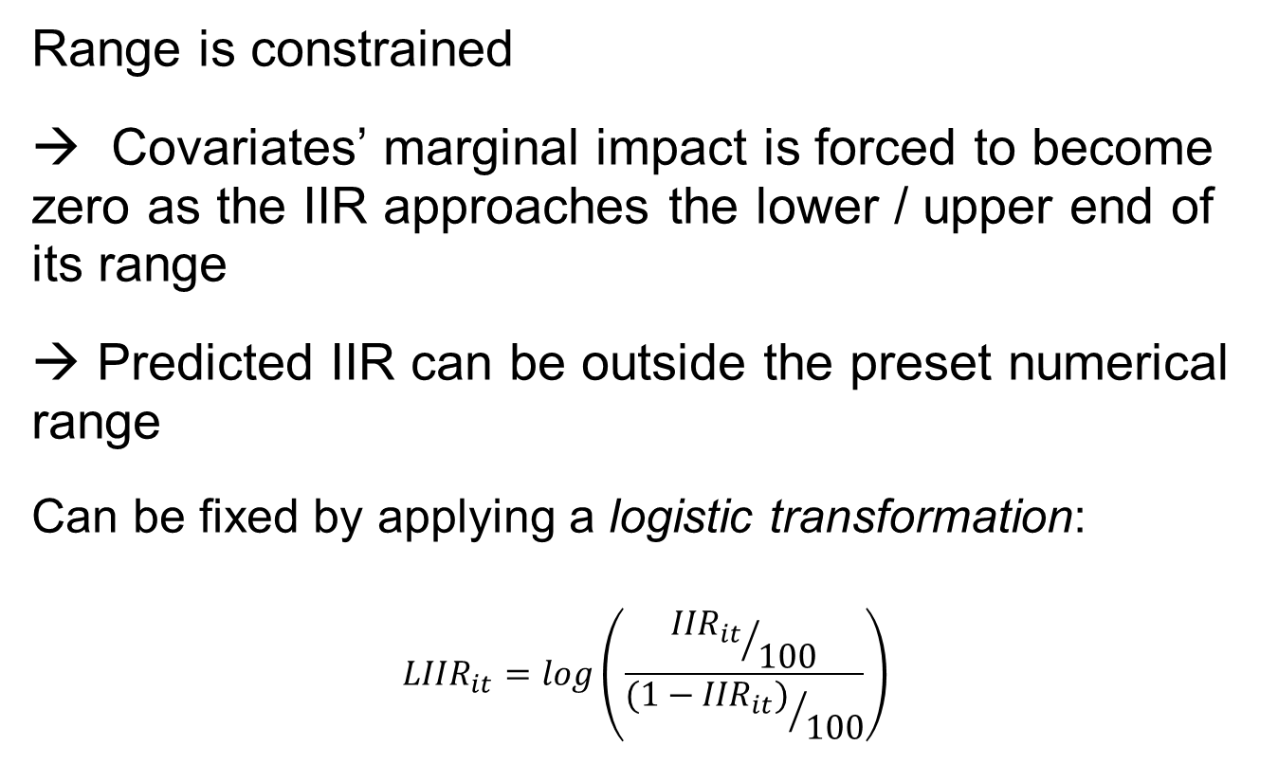
Linear IIR Index Carries a Logical Flaw (also the S&P Index)
Range is constrained
→ Covariates’ marginal impact is forced to become zero as the IIR approaches the lower / upper end of its range
→ Predicted IIR can be outside the preset numerical range
Can be fixed by applying a logistic transformation:
$${LIIR}_{it}=log\left(\frac{{{IIR}_{it}}/{100}}{{{(1−IIR}_{it})}/{100}}\right)$$

Slide 9
Logistic Transformation

Slide 10
Estimation
Lagged dependent variables correlated with country fixed effects → GMM (Arellano-Bond)
Fundamentals: standard macro factors such as per capita GDP, growth, government debt, fiscal balance, NIIR, CA balance, unemployment, inflation, fixed or floating exchange rate regime, “euroization”
Several covariates are unlikely to be strictly exogenous: shocks to current values may affect future investor perception. Instrument with lags.
Results displayed in “rating agency magnitudes” (scaled with std. of the S&P index relative to own std.)

Slide 11
Core Results: Fundamentals

Slide 12
Core Results: Euro Premium I

Slide 13
Core Results: Euro Premium II

Slide 14
Core Results: Summary
Investor Perception Indices, euro premium: Pre-crisis: euro premium of about one rating agency notch. Premium disappeared in crisis. Premium returned gradually in the course of the recovery, but at a reduced value.
Investor perception index, EU premium: No evident fluctuations over time
S&P Index, euro premium: More negative than investors toward the euro throughout. Sustained downgrade (until 2012), recovery just to “neutral”.

Slide 15
Control for Institutional Quality

Slide 16
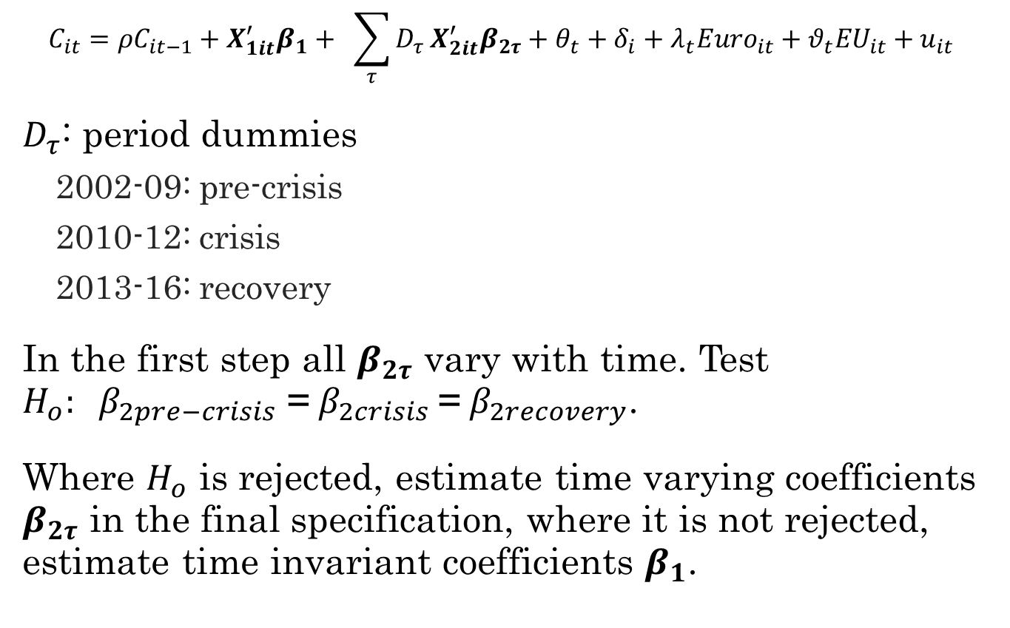
Time-Varying Assessment of Fundamentals: Approach
$$C_{it}={ρC}_{it−1}+X_{1it}^{′}β_{1}+ \sum_{τ}{D_{τ}}X_{2it}^{′}β_{2τ}+θ_{t}+δ_{i}+{λ_{t}Euro}_{it}+θ_{t}{EU}_{it}+u_{it}$$
$D_{τ}$: period dummies
2002-09: pre-crisis
2010-12: crisis
2013-16: recovery
In the first step all $β_{2τ}$ vary with time. Test ${H_{o}: β}_{2pre−crisis}$ =$β_{2crisis}$=${ β}_{2recovery}$.
Where $H_{o}$ is rejected, estimate time varying coefficients $β_{2τ}$ in the final specification, where it is not rejected, estimate time invariant coefficients $β_{1}$.

Slide 17
Time-Varying Assessment of Fundamentals: Results I

Slide 18
Time-Varying Assessment of Fundamentals: Results II

Slide 19
Time-Varying Assessment of Fundamentals: Results III

Slide 20
Conclusions
Encouraging news for Europe’s common currency: after taking a severe hit during the euro area crisis, the euro’s reputation has begun to recover.
Reduced-from approach–does not allow to identify the causes behind these patterns. Can be “whatever it takes”, institutional reforms, or just the influence of the euro area recovery on perceptions.
Since the crisis, investors pay more attention to public debt, external imbalances, and the capacity to generate growth.
Changes have persisted throughout the recovery—investors appear to have learned their lesson.

